Slide 1
OVS DOCA - The Evolution of hardware acceleration
Maor Dickman, OVS+OVN Conference, Fall 2024

Slide 2
Agenda
• | Purpose & Motivation
• | Existing Hardware Accelerated OVS (Kernel/DPDK)
• | Vendor specific accelerations
• | What is NVIDIA DOCA?
• | OVS DOCA accelerations
• | Summary

Slide 3
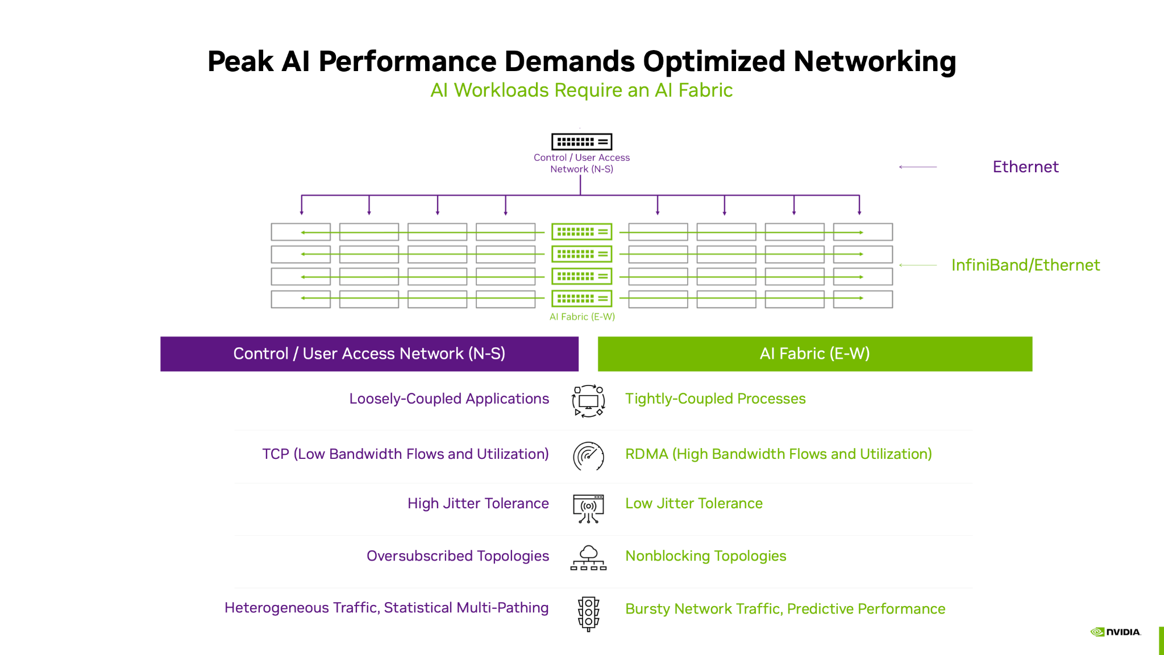
Purpose & Motivation
Data centers networking becomes ever more demanding.
Throughput > 100G
Low and predictable latency
High concurrent connections
High connections rate combined with high packet rate
RDMA
Security
AI workloads raise the bar, demanding more performance, lower latency, and advanced networking capabilities, all at a much higher bandwidth (200/400G+)
Implications
Current HW accelerated OVS (Kernel/DPDK) falls short of meeting today’s demands and tomorrow’s challenges
Customers look for alternative solutions or develop their own OVS

Slide 4
OVS kernel Acceleration
Accelerated OVS based on Kernel API:
Megaflows offload using TC flower (traffic control) module APIs
Connection tracking offload using Kernel netfilter module
Pros:
Mature - firstly introduced in OVS v2.14.0 and Linux kernel v4.10
Large feature set
Stable
Generic API (no vendor specific)
Cons:
Slow control path (low programming rate)
Slow time to market
Long kernel development cycles
Long time till change propagated to Linux distribution
Feature set depend on running kernel
TC API is limited and can’t support advanced HW features (dp_hash for example)
High latency for non-offloaded packets
Slowpath performance doesn’t meet requirements
Risky - bug in kernel can crash the system
CLI
OpenFlow
OVS
DPIF Netdev (DPDK)
DPIF Netlink (kernel)
Netdev Offload (DPDK)
Netdev Offload TC
DPDK rte_flow
TC
PMD driver
Kernel driver
Hardware
Legend
Community
Vendor specific

Slide 5
OVS DPDK Acceleration
Accelerated OVS DPDK using rte_flow API
Pros:
Kernel bypass
faster control path (higher programming rate)
faster slowpath
No kernel dependency
Cons:
Poor feature set
DPDK rte_flow API is too low level
Missing HW abstraction
Requires consensus from all vendors
rte_flow API is limited and can’t support advanced HW features (dp_hash for example)
Connection tracking offload not supported
CLI
OpenFlow
OVS
DPIF Netdev (DPDK)
DPIF Netlink (kernel)
Netdev Offload (DPDK)
Netdev Offload TC
DPDK rte_flow
TC
PMD driver
Kernel driver
Hardware
Legend
Community
Vendor specific

Slide 6
OVS new model

Slide 7
Vendor specific Accelerations
Each vendor will implement its own offload API
Vendor specific DPIF
Implement both offload and slowpath handling
Full flexibility
Allow each vendor to define its own HW access model while still be align with OVS APIs
Largest feature set
Full utilization of HW capabilities with vendor own APIs
Fastest programming rate (CPS)
Direct access to HW from userspace
No need to cross multiple layers
Best offload performance (PPS)
Optimized usage of HW APIs and resources
Time to market
No dependency on 3rd party development and release cycles
CLI
OpenFlow
OVS
DPIF Netdev (DPDK)
Vendor specific DPIF
DPIF Netlink (kernel)
Netdev Offload (DPDK)
Netdev Offload TC
DPDK rte_flow
TC
PMD driver
Kernel driver
Hardware
Legend
Community
Vendor specific

Slide 8
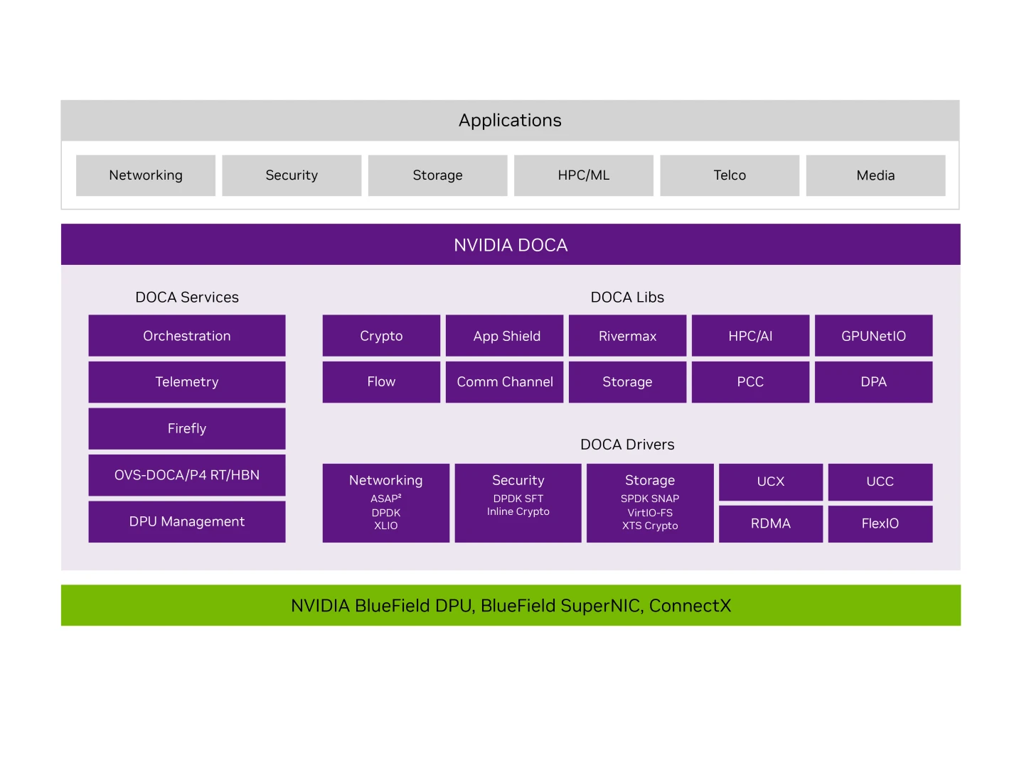
What is NVIDIA DOCA?
NVIDIA DOCA package contains services, libraries and drivers for NVIDIA NICs management and programmability.
DOCA drivers - Linux drivers and DPDK for HW access.
DOCA libraries - industry-standard open APIs for network acceleration
DOCA DMA - API for HW accelerated data copy
DOCA Flow - API for building generic packet processing pipes in hardware.
DOCA Flow Connection Tracking (CT)
DOCA ETH - API for send/receiving packets
DOCA Compress - HW accelerated compress/decompress API
DOCA services - DOCA-based products.
DOCA Firefly - Time synching service through precision time protocol (PTP)
Host-based Networking (HBN) - allow designing a network purely on L3 protocols
OVS-DOCA - OVS with DOCA acceleration.

Slide 9
OVS DOCA Acceleration
Highly optimized vSwitch for Nvidia Network Services
Based on NVIDIA DOCA SDK which provides industry-standard open APIs and software frameworks for NVIDIA networking acceleration.
Implement new DOCA DPIF which utilize DOCA-FLOW library for offloads.
DOCA-FLOW is NVIDIA SW API for Network acceleration
Uses Hardware steering (HWS) offload for best programing rate (x10+)
No impact on existing DPDK and Kernel DPIFs
Preserves existing northbound APIs (OpenFlow)
Supported with OVN-24.03 and OVN-K8s GA 1.0
https://ovn-kubernetes.io/features/hardware-offload/ovs-doca/
Support extended feature set
Tunnels: vxlan, gre and Geneve
Optimized Connection tracking (PPS+CPS)
DP_HASH
sFLOW
Perform extremely well
Slow path handling, insertion rate (CPS), Optimized pipes (PPS)
CLI
OpenFlow
OVS
DPIF Netdev (DPDK)
DPIF DOCA
DPIF Netlink (kernel)
Netdev Offload (DPDK)
DOCA Offload
Netdev Offload TC
DPDK rte_flow
DOCA FLOW
TC
PMD driver
Kernel driver
Hardware
Legend
Community
NVIDIA

Slide 10
OVS DOCA release and roadmap
NVIDIA OVS-DOCA is globally available as part of DOCA package (current version 2.9)
Based on upstream OVS LTS 3.3
Supported features:
VLAN
Tunnels: VLXAN, GRE, GENEVE+options.
Header rewrite
Connection tracking (with and without NAT)
sFLOW
Mirroring
DP_HASH
Meter
Hairpin
Bonding (high availability)
Download:
https://developer.nvidia.com/doca-downloads
User manual:
https://docs.nvidia.com/doca/sdk/nvidia+openvswitch+acceleration+-+ovs+in+doca/index.html
Roadmap:
Upstream DOCA DPIF
Live update (Nov2024 LTS)
Security acceleration (IPSec and PSP)
Improved debuggability
Scale

Slide 11




Summary
OVS-DOCA improves performance metrics for both fastpath and slowpath to meet existing and future networking demands while maintaining compatibility with the OVS architecture.
OVS-DOCA surpassed both kernel and DPDK versions in performance and features
 | OVS-Kernel | OVS-DPDK | OVS-DOCA
Acceleration​ | Accelerated | partially accelerated | Accelerated
Slowpath perf
CPS​
Fastpath perf | (*Fastpath offloaded) | (*In price of more CPU)
CPU usage
Time to market

Slide 12
Thank you!
Questions?
Example Slides

